Slide 1

MLOps
The MLOps process overview
10 Jan 2022

Slide 2
Objectives
Develop Inactivity churn model.
Using ML-Ops practices, deploy and maintain the machine learning model in production reliably and efficiently.
Visualize the key performance metrices/results using data studio dashboard.
Monitor the model performance after deployment and enable the retrain capabilities.

Slide 3
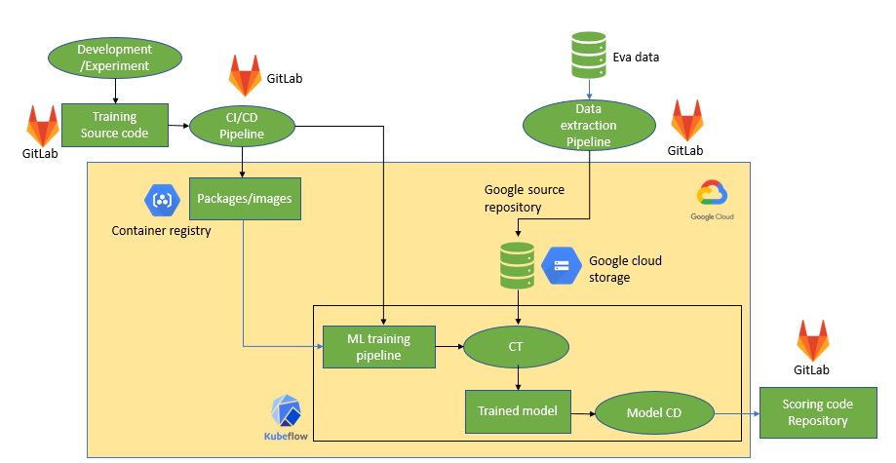
ML OPS PROCESS FLOW FOR MTN SOUTH AFRICA (TRAINING)

Slide 4
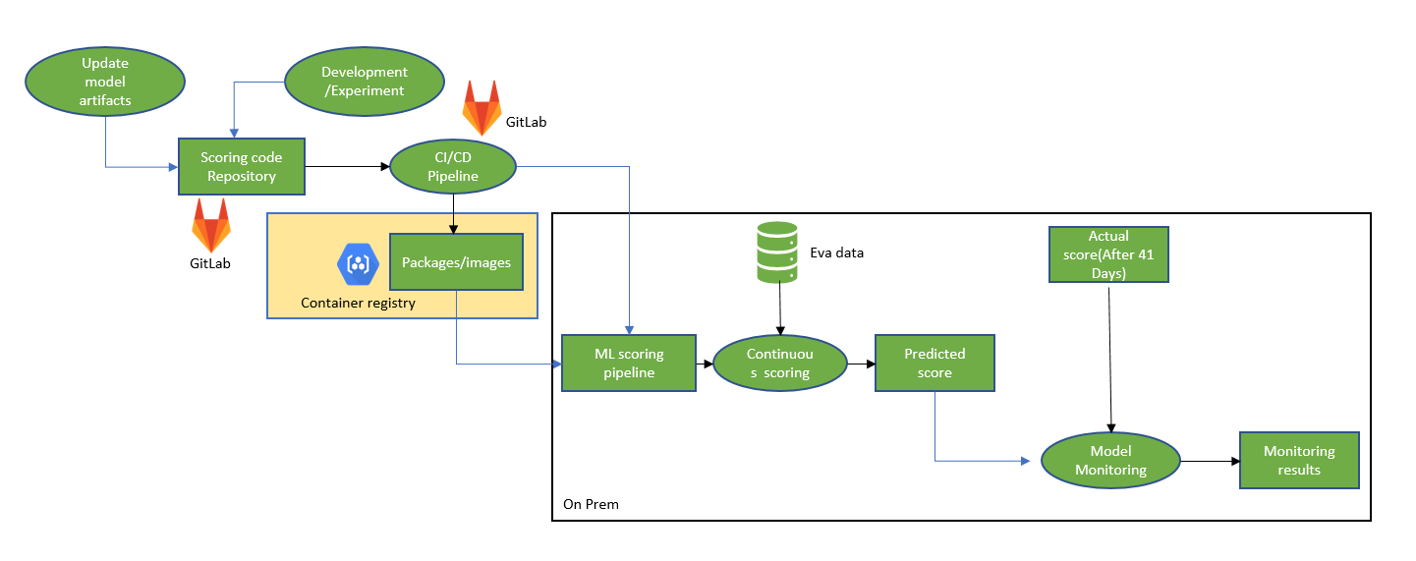
ML OPS PROCESS FLOW FOR MTN SOUTH AFRICA (SCORING)

Slide 5












MLOps Architecture: Detailed
MLOps To-Be Architecture
Detailed architecture with repositories, training and scoring pipeline.
Gitlab Source Repository
Gitlab CI/CD Pipleine
Components source code
Unit tests
Run unit tests
Push to Container Registry
Container Registry
Component specs
Dockerfiles
Trigger build
Create docker images
Container images for the Kubeflow Pipelines components
Notebooks
Scripts
Update component specs
Upload to Cloud Storage
Cloud Storage
Kubeflow pipelines workflow source code
Settings
Compile Kubeflow Pipelines
Kubeflow Pipelines files
Scheduler
Download container images
Push/Merge
Release gateway
Deploy and run
Data science environment
Google Kubernetes Engine environments (develop, test, staging, pre-production)
AI Platform Notebooks
Experimenting
Kubeflow Pipelines
Retrain model
Data extraction
Data validation
Data transformation
Model training
Model evaluation
Model validation
Model serving
Trigger
Trained model
Deploy
ML metadata Cloud Storage
Commit code
Data analysis (data drift etc.)
Model registry AI Hub
Manual retraining
Feature Store Cloud Storage
Performance monitoring
Continuous training
Extract data
EVA
Write data
Scoring Pipeline
EVA
Developers
Data scientists
Data drift detected
Notes:
Power bi dashboard (first output)
second rest api output
Wherever we can have on-prem (Anthos)
Deployment components
Highlight components that can be done BOTH online and offline (clearly marked)

Slide 6
DEMO

